Slide 1
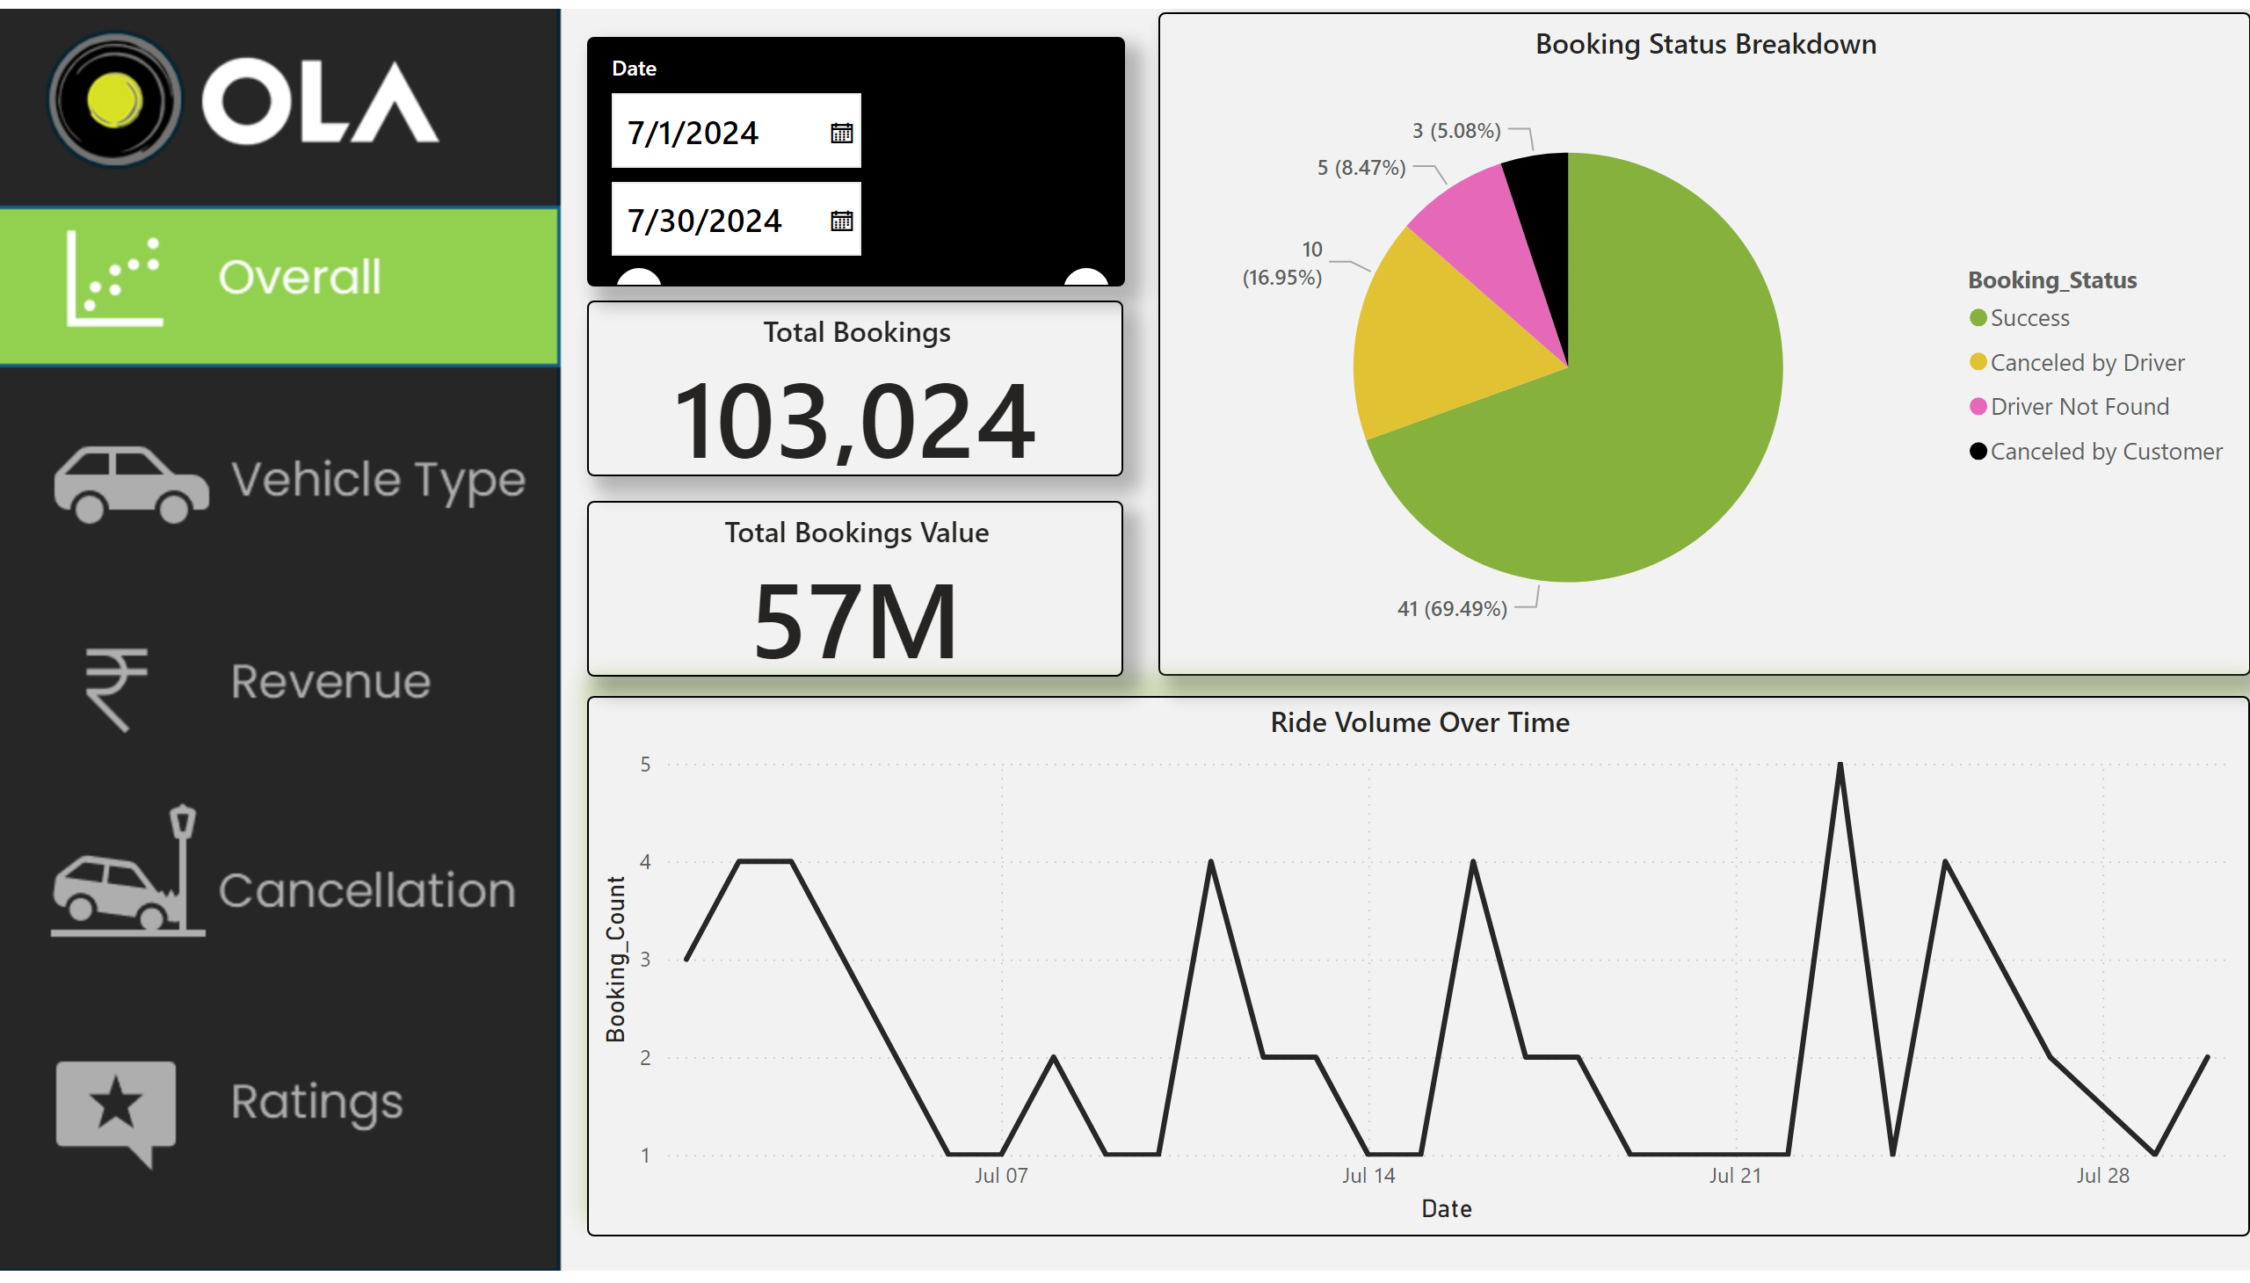
Overall
Notes:
actionButton
No alt text provided
actionButton
No alt text provided
actionButton
No alt text provided
actionButton
No alt text provided
actionButton
No alt text provided
Booking Status Breakdown
No alt text provided
Ride Volume Over Time
No alt text provided
Date
No alt text provided
Total Bookings
No alt text provided
Total Bookings Value
No alt text provided

Slide 2
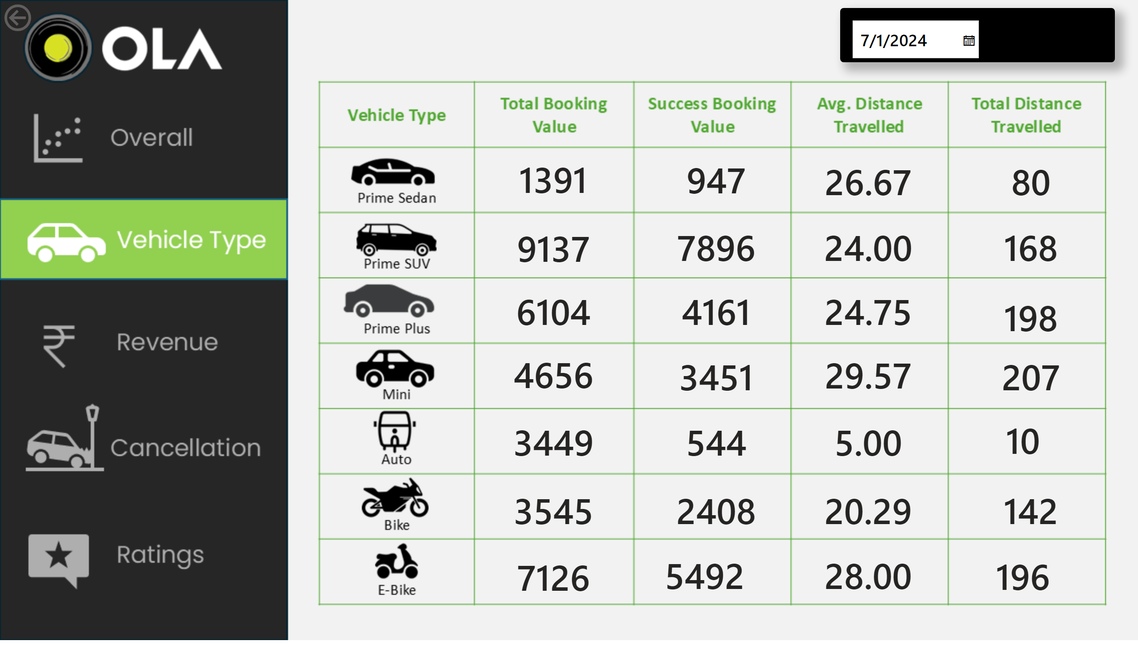
Vehicle Type
Notes:
card
No alt text provided
card
No alt text provided
card
No alt text provided
card
No alt text provided
card
No alt text provided
card
No alt text provided
card
No alt text provided
card
No alt text provided
card
No alt text provided
card
No alt text provided
card
No alt text provided
card
No alt text provided
card
No alt text provided
card
No alt text provided
card
No alt text provided
card
No alt text provided
card
No alt text provided
card
No alt text provided
card
No alt text provided
actionButton
No alt text provided
card
No alt text provided
card
No alt text provided
card
No alt text provided
card
No alt text provided
card
No alt text provided
card
No alt text provided
card
No alt text provided
card
No alt text provided
card
No alt text provided
Date
No alt text provided
actionButton
No alt text provided
actionButton
No alt text provided

Slide 3
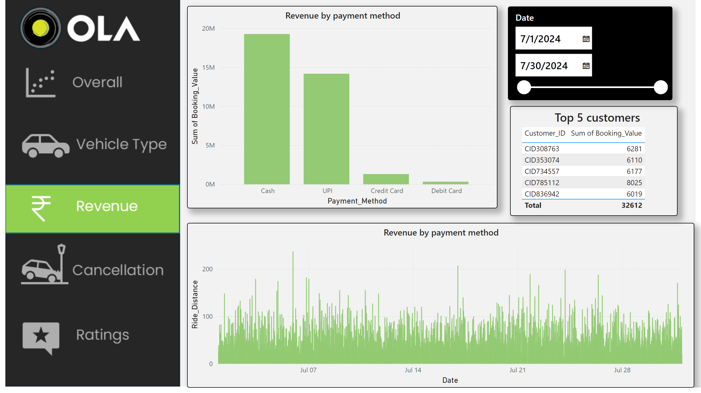
Revenue
Notes:
Revenue by payment method
No alt text provided
Date
No alt text provided
Top 5 customers
No alt text provided
Revenue by payment method
No alt text provided

Slide 4
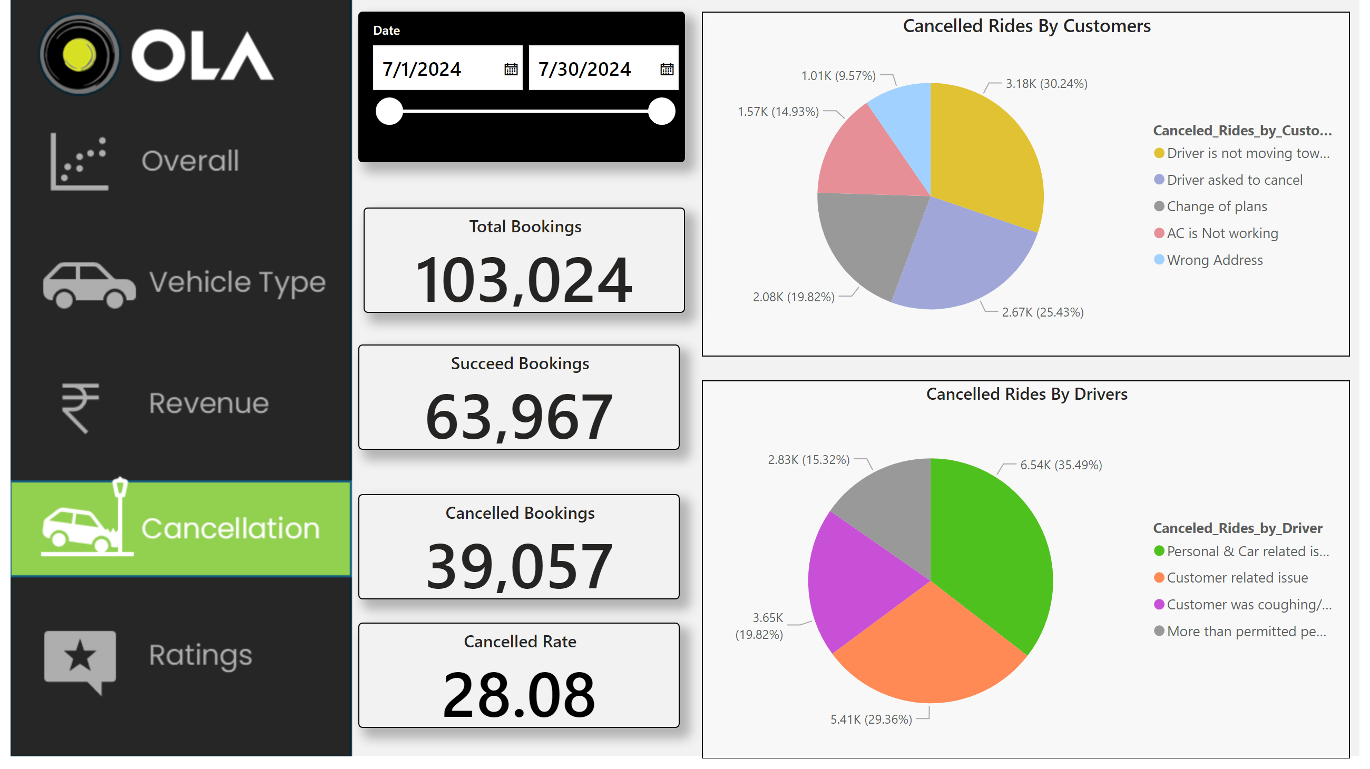
Cancellation
Notes:
Cancelled Rides By Customers
No alt text provided
Cancelled Rides By Drivers
No alt text provided
Date
No alt text provided
Total Bookings
No alt text provided
Succeed Bookings
No alt text provided
Cancelled Bookings
No alt text provided
Cancelled Rate
No alt text provided

Slide 5
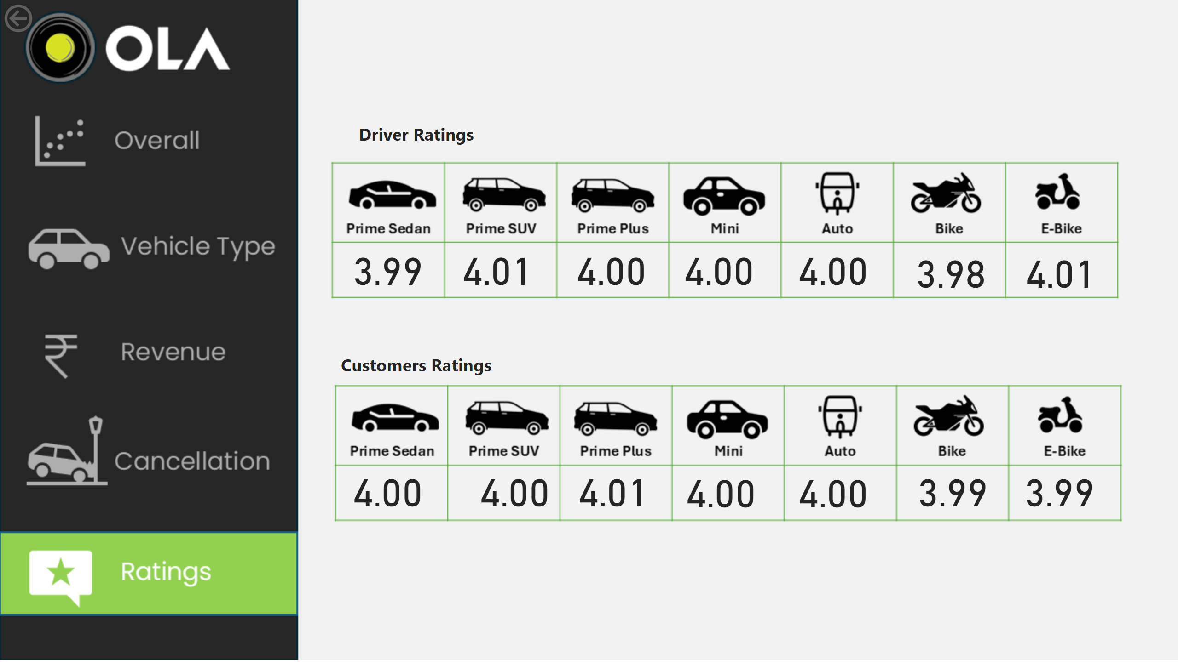
Ratings
Notes:
card
No alt text provided
actionButton
No alt text provided
card
No alt text provided
card
No alt text provided
card
No alt text provided
card
No alt text provided
card
No alt text provided
card
No alt text provided
card
No alt text provided
card
No alt text provided
card
No alt text provided
card
No alt text provided
card
No alt text provided
card
No alt text provided
card
No alt text provided
textbox
No alt text provided
textbox
No alt text provided

